Slide 1
Fundamentals of Programming for Computer Science (FoP4CS)
Dr Michael Meredith

Slide 2
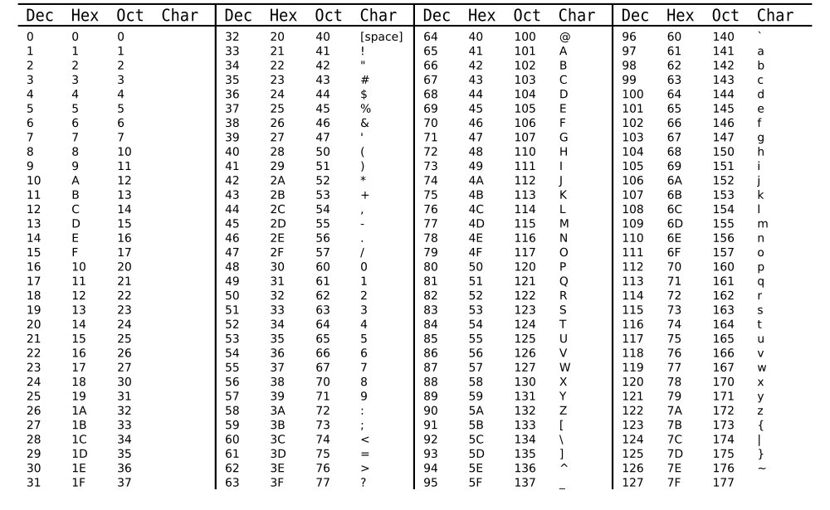
An ASCII aside

Slide 3
Arrays (more data)
Arrays offer a basic way of collecting together data of the same type
Convenient way of access the data
No need to a new variable name per item of data
Often combined with loops to perform operations on
Think of arrays as a number of boxes, where each box can store a piece of data
Individual items within an array are accessed via indexes
C++ uses zero-based indexing
[0] [1] [2] [3] [4]
[0]
[1]
[2]
[0] [1] [2] [3] [4]

Slide 4
Arrays (more data)
A 2D array is unwrapped as a long 1D array
1D index = (stride * row) + column
But the compiler deals with this for us
[0] [1] [2] [3] [4]
[0]
[1]
[2]
0
1
2
3
4
5
6
7
8
9
10
11
12
13
14
[0] [1] [2]
[0] [1] [2] [3] [4]
[0] [1] [2] [3] [4]
[0] [1] [2] [3] [4]
0
1
2
3
4
5
6
7
8
9
10
11
12
13
14

Slide 5
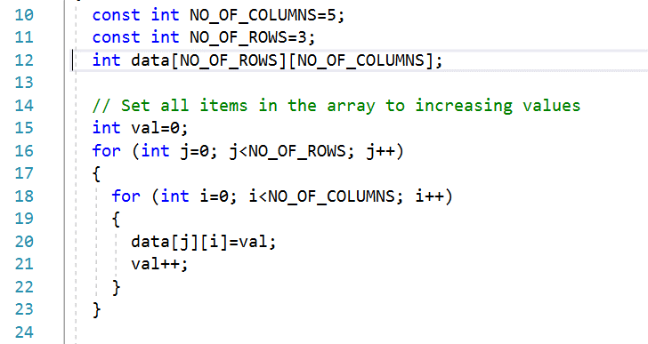
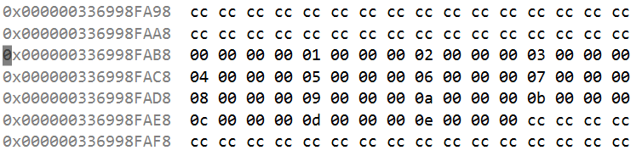
Declaring 2D Arrays

Slide 6
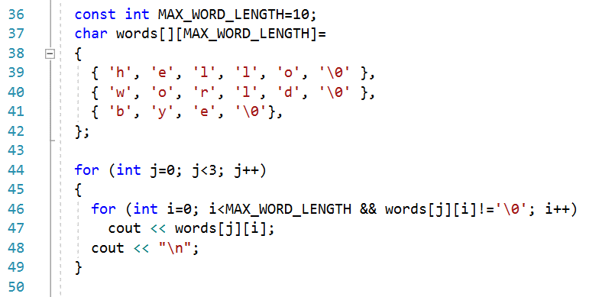
Manipulating 2D Arrays
This is your stride (and must be specified when declaring arrays on the stack)
Null-terminating character
Loop while either the max word length is reached or the null-terminating character

Slide 7
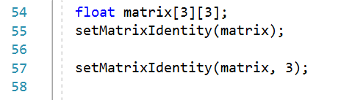
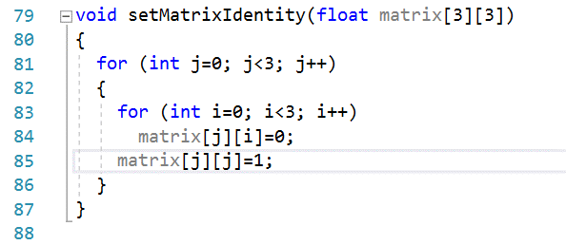
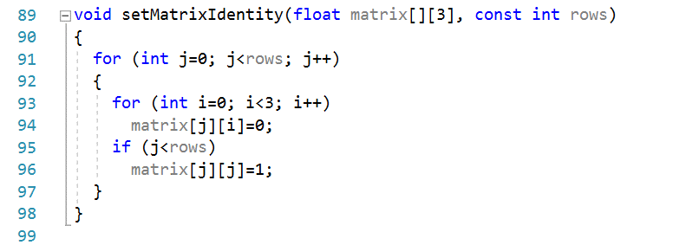
Manipulating 2D Arrays

Slide 8
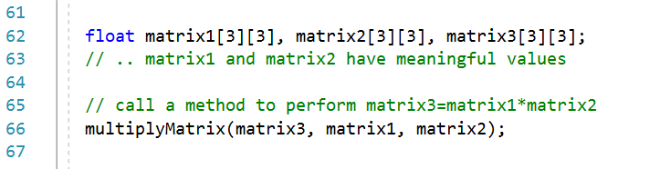
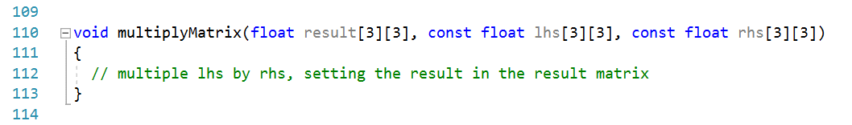
Manipulating 2D Arrays

Slide 9
The problem with our arrays (so far)
All our arrays are created on the stack, interleaved with program execution code in memory
They all have fixed sizes, determined at compile-time
What if we simply don’t know how big the array is?
Create an array that is huge and hope it is big enough
But what happens if it isn’t?
We’ll quickly run out of stack memory by allocating huge arrays
Vectors offer a suitable alternative (and we’ll learn about heap memory in time)

Slide 10
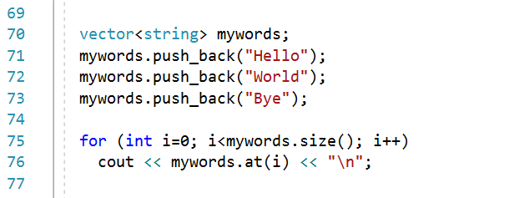
Vectors
Need to include the <vector> header file
Essentially a dynamically-resizing array

Slide 11
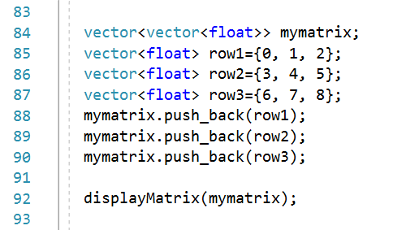
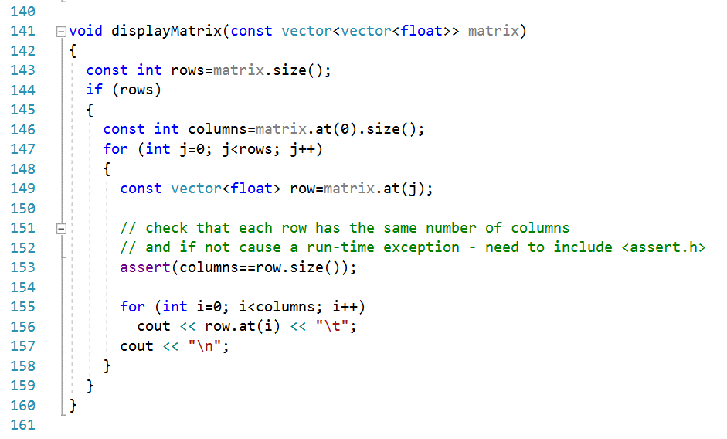
Vectors

Slide 12
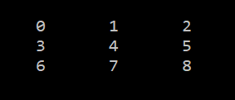
Vectors

Slide 13

FoP4CS - Key Points
ASCII characters are just a mapping between numbers and symbols
2D arrays are like 1D arrays, expect they have an extra dimension (a grid/matrix of values)
You can have n-D arrays by simply adding more ‘[]’ parts
Vectors facilitate a run-time resizable collection of items
Vectors are still typed using <type> after their declaration

